Slide 1









My Number Interactive Notebook
$$×$$
$$\frac{1}{2}$$
$$÷$$
$$+$$
$$−$$
$$\frac{3}{5}$$
$$7$$
Name
Class
Teacher
Term 1 Semester 1
$$5^{2}$$
$$\sqrt{9}$$
1

Slide 2
If $300 is invested at 10%per annum. What is the balance after 5 years if interest is added to the amount at the end of each year?
Copy and complete the table below
Time | Amount | Interest | New Amount
One year | $300
Two years
Three years
Four years
Five years

Slide 3
If $300 is invested at 10%per annum. What is the balance after 5 years if interest is added to the amount at the end of each year?
Copy and complete the table below
Time | Amount | Interest | New Amount
One year | $300 | $30 | $330
Two years
Three years
Four years
Five years

Slide 4
If $300 is invested at 10%per annum. What is the balance after 5 years if interest is added to the amount at the end of each year?
Copy and complete the table below
Time | Amount | Interest | New Amount
One year | $300 | $30 | $330
Two years | $330 | $33 | $363
Three years
Four years
Five years

Slide 5
If $300 is invested at 10%per annum. What is the balance after 5 years if interest is added to the amount at the end of each year?
Copy and complete the table below
Time | Amount | Interest | New Amount
One year | $300 | $30 | $330
Two years | $330 | $33 | $363
Three years | $363 | $36.30 | $399.30
Four years | $399.30 | $39.93 | $439.23
Five years | $439.23 | $43.92 | $483.15

Slide 6
Contents
Glossary or Formula Page
Page
Date
Description
2
3

Slide 7
Tasks
24
7
30
Essential Question
Questions
Notes
Summary

Slide 8
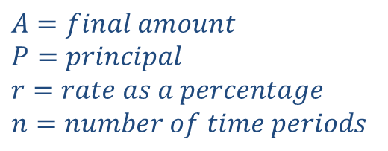
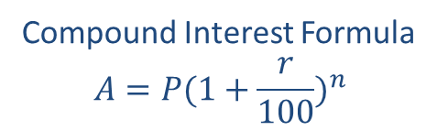
24
7
30
Date
Compound Interest
EQ – How does compound interest differ from simple interest?
What is compound interest?
Compounding is when the interest is paid on interest
Compound Interest Formula
$$A=P{(1+\frac{r}{100})}^{n}$$
How do I calculate compound interest?
$$A=final amount$$
$$P=principal$$
$$r=rate as a percentage$$
$$n=number of time periods$$
$$Interest = final amount (A) – Principal (P)$$
Example

Slide 9
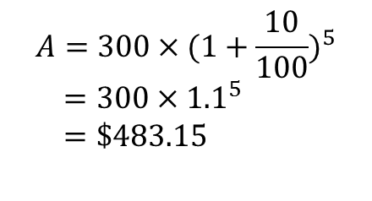
24
7
30
Date
Compound Interest
EQ – How does compound interest differ from simple interest?
What is compound interest?
Compounding is when the interest is paid on interest
Compound Interest Formula
$$A=P{(1+\frac{r}{100})}^{n}$$
How do I calculate compound interest?
$$A=final amount$$
$$P=principal$$
$$r=rate as a percentage$$
$$n=number of time periods$$
$$Interest = final amount (A) – Principal (P)$$
Example
If $300 is invested at 10%per annum. What is the balance after 5 years if interest is added to the amount at the end of each year?
$$A=300×{(1+\frac{10}{100})}^{5}$$
$=300×{1.1}^{5}$
$=\$483.15$
$$Interest = 483.15−300=\$186.15$$

Slide 10
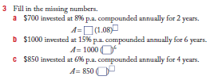


Slide 11
Notes Review
24, 7 ,30
Date
Title
Essential question
Notes complete
Notes complete with colour and diagrams
Questions completed
Contents page filed in
Formula page filled in

Slide 12
Homework
Review your notes and write a summary answering the essential question.

